Slide 1
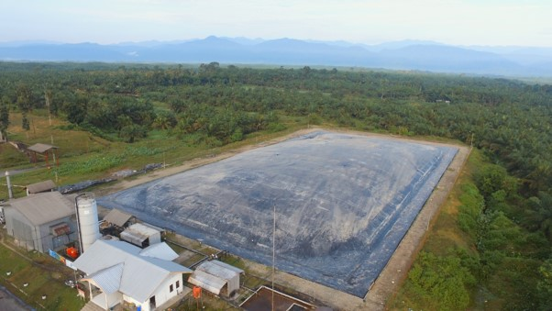
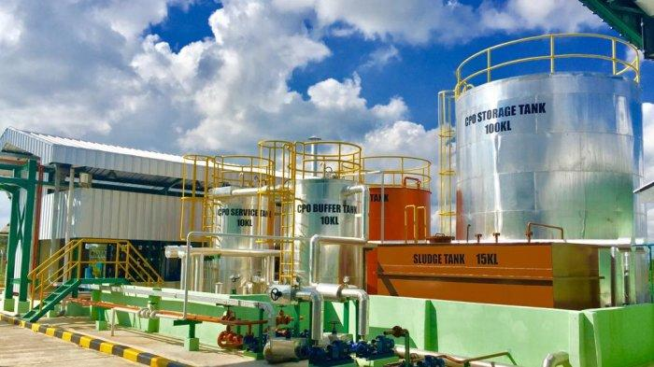
DIRECTORATE GENERAL OF NEW, RENEWABLE ENERGY AND ENERGY CONSERVATION
MINISTRY OF ENERGY AND MINERAL RESOURCES
INDONESIA
ENERGY TRANSITION
TOWARDS NZE 2060
Dadan Kusdiana
Director General of New, Renewable Energy and Energy Conservation
at Japan RE-Invest Indonesia Forum 2023
Tokyo, March 3rd, 2023
www.esdm.go.id
kesdm

Slide 2
CONDITION AND POTENTIAL OF NRE TO SUPPORT ENERGY TRANSITION
National Primary Energy Demand | MBOE
NRE in The National Energy Mix
Energy consumption rose by 30%
659.3
522.9
NRE utilization in 2022 increased by 18% (213.8 MBOE), from 2021 consumption.
448.6
366.4
*) Temporary Data
Electricity Consumption | kWh/capita
National NRE Potential and Utilization
ENERGY | POTENTIAL (GW) | UTILIZATION (MW)
SOLAR | 3,295 | 272
HYDRO | 95 | 6,689
BIOENERGY | 57 | 3,087
WIND | 155 | 154
GEO THERMAL | 24 | 2,355
OCEAN | 60 | 0
TOTAL | 3,686 | 12,557
Hydro: all over Indonesia’s areas, particularly in North Kalimantan, NAD, North Sumatra and Papua.
Solar: all over Indonesia’s areas, particularly in East Nusa Tenggara, West Kalimantan and Riau which has higher radiation.
Wind (>6 m/s): particularly located in East Nusa Tenggara, South Kalimantan, West Java, NAD and Papua.
Ocean: all over Indonesia’s areas, particularly in Maluku, East Nusa Tenggara, West Nusa Tenggara and Bali.
Geothermal: in ring of fire areas, including Sumatra, Java, Bali, Nusa Tenggara, Sulawesi, and Maluku.
National electricity consumption in 2022 amounted to 1,173 kWh/capita, lower than the average electricity consumption in ASEAN of 3,600 kWh/capita.
Note:
*) December 2022
Nuclear pot.: Uranium 89,483 tons - Thorium 143,234 tons

Slide 3
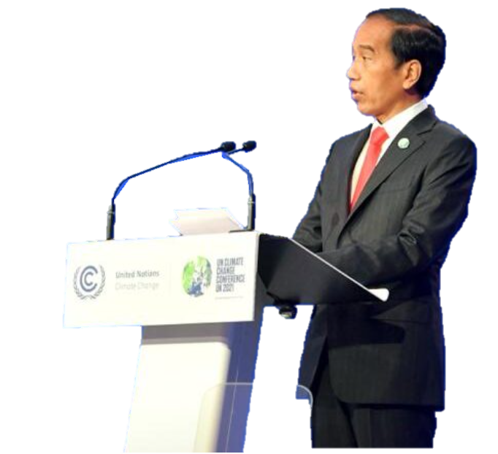
INDONESIA COMMITMENT IN GHG EMISSION REDUCTION
The G20 leaders reiterated the commitment to achieve global net zero greenhouse gas emissions/carbon neutrality by or around mid-century, while taking into account the latest scientific developments and different national circumstances.
The commitment to achieve the targets of SDG7 was also reaffirmed and the gaps in energy access will be closed to eradicate energy poverty.
Bali Compact and Bali Roadmap are regarded as the guides to realize energy market stability, transparency, and affordability.
Enhanced NDC
No | Sector | 2010 GHG Emission (Million Ton CO₂e) | GHG Emission by 2030 |  |  | Reduction
 |  |  | BaU | CM1 | CM2 | CM1 | CM2
1. | Energy | 453.2 | 1,669 | 1,311 | 1,223 | 358 | 446
2. | Waste | 88 | 296 | 256 | 253 | 40 | 45.3
3. | IPPU | 36 | 70 | 63 | 61 | 7 | 9
4. | Agriculture | 111 | 120 | 110 | 108 | 10 | 12
5. | FOLU | 647 | 714 | 217 | -15 | 500 | 729
 | TOTAL | 1,334 | 2,869 | 1,953 | 1,632 | 915 | 1,240
G20 Presidency
“Recover Together,
Recover Stronger”
Bali COMPACT
Nine voluntary principles for accelerating clean, sustainable, just, affordable, and inclusive energy transitions to ensure smooth and effective transitions in accordance with national circumstances and priorities.
Bali Roadmap
Outlining concrete actions to address energy transition effort among members, by realizing three priorities (energy accessibility, technology scale-up, and financing) through active involvement and collaboration of G20 countries.
Note: CM: Counter Measure; CM1: self effort; CM2: international assistance; IPPU: industrial processes and production use
Unit: Million Tons CO₂e
Through Enhanced NDC Indonesia raised its carbon emission reduction target, the energy sector has increased from 314 million tonnes of CO2e to 358 million tonnes of CO2e
Every year, the emission reduction is increasing above the target. By 2022, the energy sector was able to reduce GHG emissions by 91.5 million tonnes of CO2e.
COP 27, NOVEMBER 20, 2022
Indonesia continues to take concrete steps, including GHG emission reduction by increasing the target to 31.89% with its own ability, and 43.20% with international support.

Slide 4
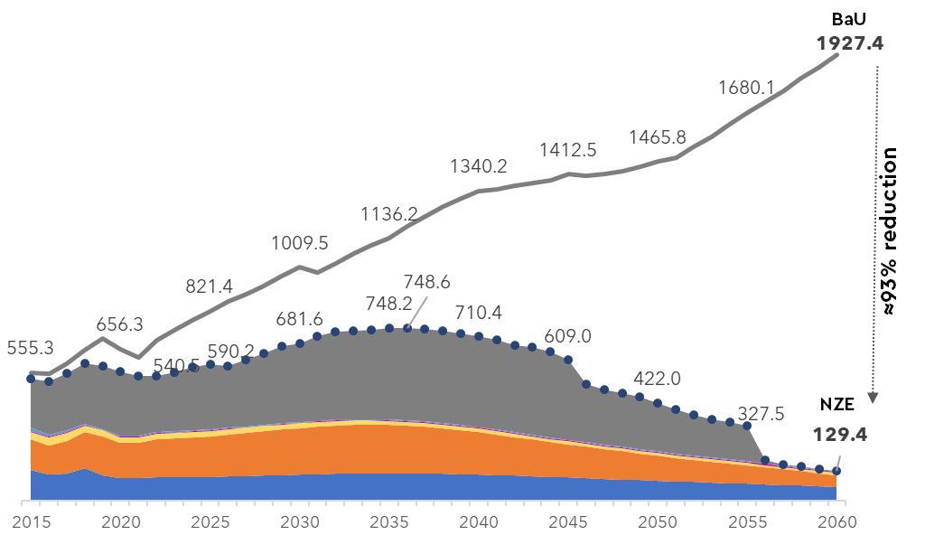
STRATEGIES TO ACHIEVE NZE 2060 IN ENERGY SECTOR
Net Zero Emission 2060 | Million Ton CO₂e
Roadmap for NZE 2060 or sooner
Supply:
NRE Development based on RUPTL 2021-2030, cofiring on CFPP
Demand:
Induction stove, city gas expansion, B35 mandatory, EV, energy management mandatory & MEPS.
Supply:
Green Hydrogen utilization begin in 2031 for transportation sector, BESS in 2034
Demand:
Induction stove, gas network, B40 mandatory, EV, energy management, & hydrogen for transportation sector
Supply:
Green Hydrogen utilization begin to substitute natural gas, NRE dominate the energy mix
Demand:
Induction stove, gas network, B40 mandatory, EV, & hydrogen for industry.
93% emission reduction from BaU will be realized by optimizing supply side by using NRE and demand side by energy efficiency.
2021-2025
2026-2030
2031-2035
2036-2040
2041-2050
2051-2060
Supply:
NRE Development based on RUPTL 2021-2030, pump storage starts by 2025
Demand:
Induction stove, gas network, B40 mandatory, DME, EV.
Supply:
Nuclear PP starting 2039, massive Solar PV development, along with onshore and offshore wind PP.
Demand:
Induction stove, gas network, B40 mandatory, EV, and CCS for cement and steel industry
Supply:
All electricity are generated by NRE PP. Remaining GHG emission level: 129 million tons CO2.
Demand:
Induction stove, gas network, EV, and CCS for industry
NZE Strategies
1
Electrification (EV, induction stove,
electrifying agriculture, etc)
3
CFPP Moratorium & early retirement of existing CFPPs
5
CCS/CCUS
2
4
New energy sources
(hydrogen and ammonia)
Energy management mandatory and MEPS
NRE Development
(offgrid, ongrid, biofuel)
6
Notes:
Electricity demand in 2060 will reach 1942 TWh dominated by Industry and Transportation sectors. All electricity demand is supplied by 96% renewable energy-based power plants and 4% new energy-based power plants (Nuclear PP) with total capacity of 708 GW. VRE generates 77% capacity of total renewable energy which is equipped with storage technology: pumped storage and Battery Energy Storage System (BESS).

Slide 5
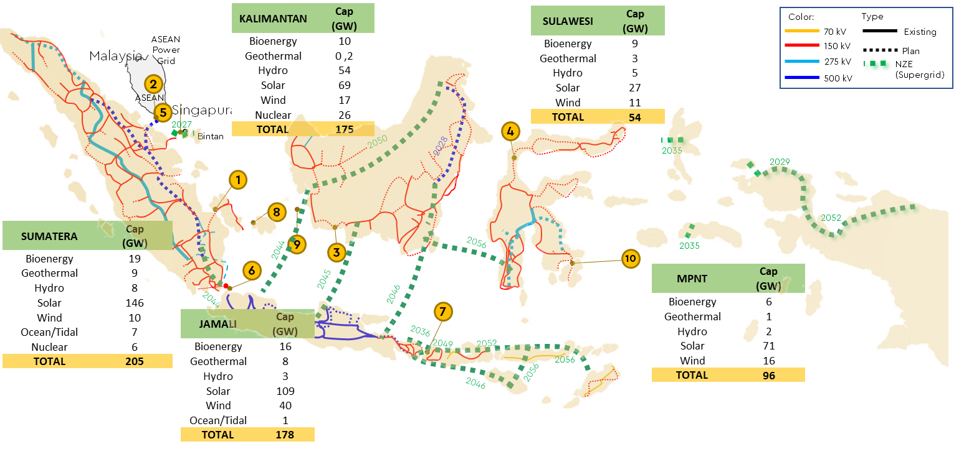
OPTIMIZING NRE: SUPER GRID DEVELOPMENT, REBID, & MINERAL DOWNSTREAMING
Super Grid and RE Sharing Resources
Indonesia's Mineral Potential to Support the Energy Transition
Power Generators
(Solar, Wind, & Nuclear)
Ni
Co
REE
U
Nickel
Cobalt
Rare earth elements
Uranium
Cr
Zr
Mn
CU
Al
Transmission & Distribution
Chromium
Zirconium
Manganese
Copper
Alumunium
Energy Storage (Machinery and EV Battery; Hydrogen)
Smelter Development Plan (2022: 5 Completed and 2 Construction)
In order to optimize Indonesia’s unique circumstances as an archipelagic country in which RE resources are widespread all over the country, a modern and integrated super grid is required, to establish resilient and robust transmission infrastructure in Indonesia.
Objectives:
Ramping up renewable energy development.
Maintaining the transmission stability and security.
Addressing mismatch between renewable energy resources and the location of high electricity demand area.
Providing and expanding energy access.

Slide 6
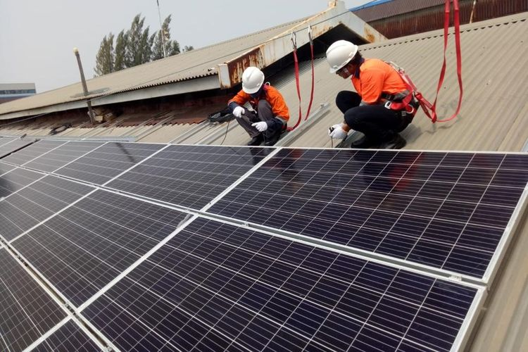
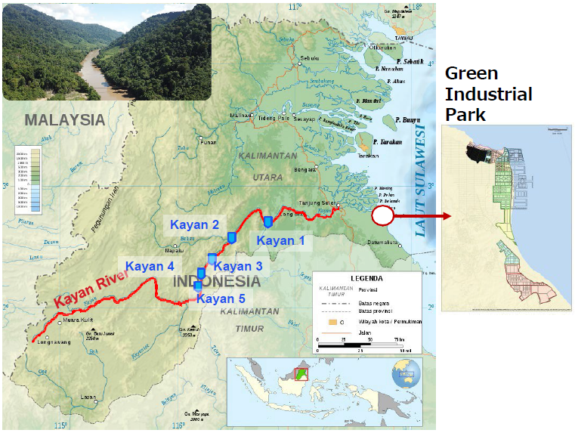
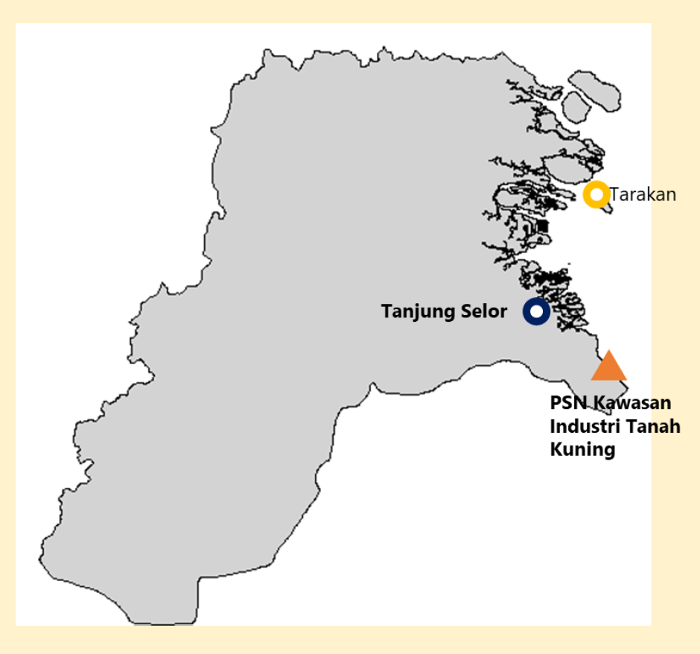
NREEC OPPORTUNITIES FOR GREEN INVESTMENT
Utilizing NRE for Industry
RENEWABLE ENERGY BASED INDUSTRIAL DEVELOPMENT (REBID)
REBID is carried out through a “demand creation” approach to integrate regional and industrial development, attract investment, and increase regional economic development
Rooftop Solar PV
Regulated in the MEMR Decree No. 26/2021, currently under revision to further accelerate the implementation.
As of December 2022, 80.45 MWp of Rooftop Solar PV has been installed by 6,522 customers.
Reduce emissions and monthly electricity bills.
Industrial Area
Large Hydropower & Direct Use Geothermal Project
Industrial Growth Regions
NRE Sources
Special Economic Area
Hydropower projects to be developed include 9,000 MW Kayan Hydropower that will be develop in stages and Mentarang Hydro 1,375 MW.
Other large scale hydro potential project includes Mamberamo hydropower in Papua.
Geothermal has a high thermal efficiency (80-90%)
Many resources of shallow geothermal for potential direct use.
Generally used for the agricultural sector (such as tea, coffee, palm sugar) and tourism (hot springs)
Industrial Development Area
Green Industry Development in Tanah Kuning Industrial Area:
In accordance with the Directive of the President of the Republic of Indonesia on October 13, 2021 to develop 20 thousand hectares of Green Industrial Park in North Kalimantan
Will be the location of industrial development
Renewable fuels, green hydrogen
New energy battery
Ternary Cathode
Green Aluminium
Utilization of Waste and Biomass
Utilization of waste/biomass as boiler fuel has been carried out in industries such as PT. Sari Husada, Holcim Cement Factory, Pulp and Paper Industry, etc
The use of waste/biomass in small and medium industries such as tile and ceramics industries is common in society
Biomass is also used in the cofiring program, with existing CFPPs

Slide 7
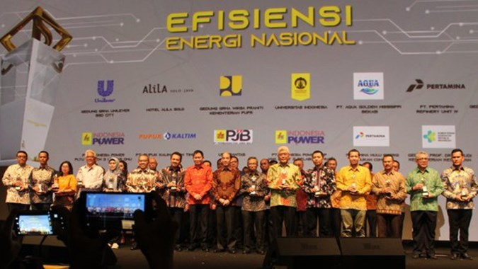
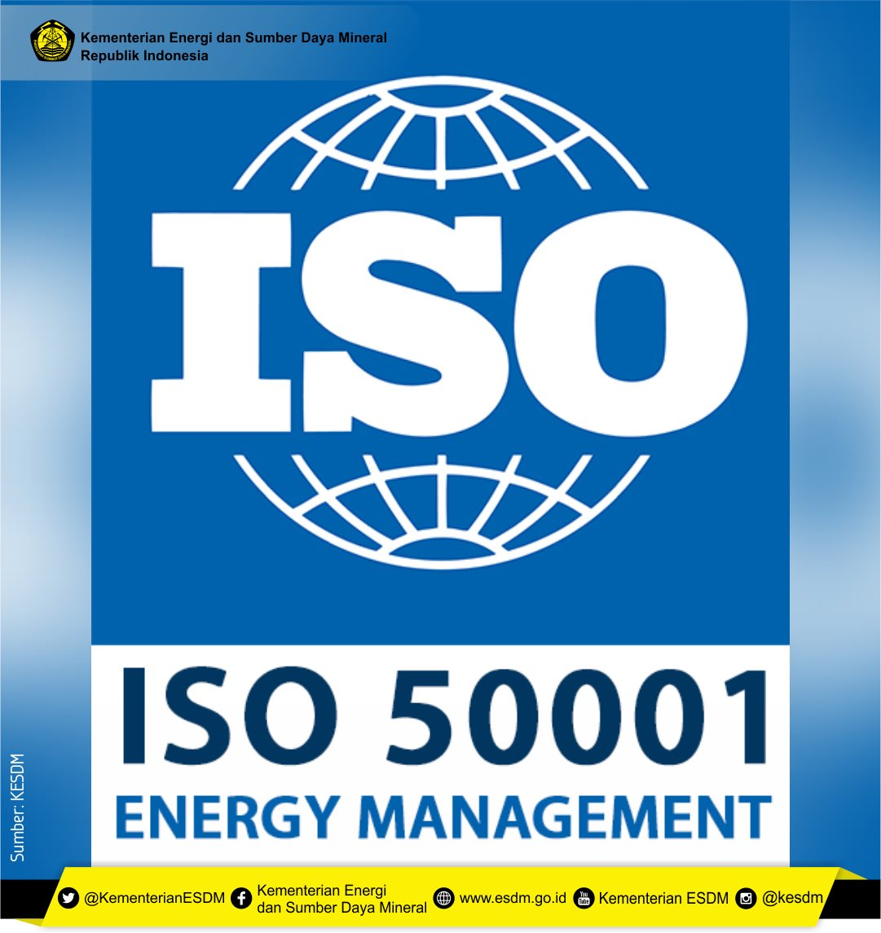
ENERGY CONSERVATION PROGRAM
Standardization and Labeling Application
Standardization and Label for Appliances
Regulation for Energy Efficiency in buildings through SNI:6390:2020 Energy Conservation of air conditioning systems in buildings. It provides recommendations for Coefficient of Performance (COP) Value for electric air conditioning (chillers).
Implementation of Energy Saving Technology (inverter technology, electric motor, boiler, etc.)
Roadmap for mandatory home appliances MEPS 2021-2030
Lamps (Tech Neutral)
(GWh)
Blender
Water Pump
Mandatory of Energy Management Implementation
(ISO 50001)
Iron
The implementation of MEPS can save the energy up to 8% (98,632 GWh) or 62 MBOE and will reduce GHG 83.8 Million Tons of CO2
Washing Machine
Water Dispenser
AC
Electric Fan
Energy Efficiency Investment, energy conservation service business development
TV
Refrigerator
Rice Cooker
Awareness & Awards.
Potential Minimum Energy Performance Standards for the industrial sector: Electric vehicles, chillers, transformers and boilers.

Slide 8
STRENGTHENING NREEC POLICIES TO ACCELERATE ENERGY TRANSITION INVESTMENT
PRES. REGULATION NUMBER 112/2022
PRES. REGULATION NUMBER 11/2023 on Additional Concurrent Government Affairs in the Energy and Mineral Resources Sector for the NRE Subfield.
RE development is carried out based on the RUPTL document, with consideration of the NRE mix target, supply-demand, and economic value.
To support the utilization of EBT in the primary energy mix and the achievement of global emission reduction, it is necessary to optimize the authority of coordination and synergy between the Government and Regional Governments.
Highest Benchmark Price (HPT) for 2-stage staging without escalation with location factors applies to stage 1, for each type of renewables:
Jenis | Stage 1 (cUSD/kWh) | Stage 2 (cUSD/kWh)
Geothermal | 7.65 – 9.76 x F | 6.5 – 8.30
Large Hydro | 6.74 – 11.23 x n x F | 4.21 – 7.02
Excess Power Hydro | 5.80 x 0.7
Solar | 6.95 – 11.47 x n x F | 4.17 – 6.88
Wind | 9.54 – 11.22 x n x F | 5.73 – 6.73
Biogas | 7.44 – 10.18 x n x F | 4.46 – 6.11 x n
Biomass | 9.29 – 11.55 x n x F | 7.43 – 9.24 x n
Additional Concurrent Government Affairs for Local Governments:
management of Biomass and/or Biogas supply within the province.
a
management of the utilization of Biomass and/or Biogas as fuel in the provincial area
b
management of Various New Renewable Energy sourced from solar, wind, waterfall, as well as the movement and temperature difference of the ocean layer, within the province.
c
Energy Conservation management for activities whose business license is issued by the provincial region
n: Technical factor (0.7 – 1.0) F: Location factor (1 – 1.5)
d
Deal Price (requires MEMR approval): Peaker Hydro; Biofuel PP; Ocean PP
implementation of Energy Conservation in facilities and infrastructure managed by the regional apparatus that organizes government affairs in the field of energy and mineral resources.
Pres. Regulation 112/2022 also mandates the Government c.q. The MEMR to prepare a roadmap to accelerate the retirement of the CFPP's operational life and limit the development of new CFPPs, except for those CFPPs that have been listed in the RUPTL or which are integrated with industry; committed to reduce GHG more than 35% in 10 years since CFPP started operation through technology dev., carbon offset, and/or increasing RE mix; and operated until 2050.
e
guidance and supervision of the implementation of Energy Conservation carried out by stakeholders at the provincial level.
f
NRE LAW DRAFT
“
“
ENERGY TRANSITION ROADMAP
NRE RESOURCES
NUCLEAR
LICENSE & PERMIT
RESEARCH & DEVELOPMENT
PRICE
INCENTIVE
As a comprehensive regulation to create a sustainable and fair climate for NRE development
NRE FUND
LOCAL CONTENT
INSITUTIONAL AUTHORITY
GUIDANCE AND SUPERVISION
PUBLIC PARTICIPATION
NRE PROVISION OBLIGATION
ENERGY CONSERVATION

Slide 9
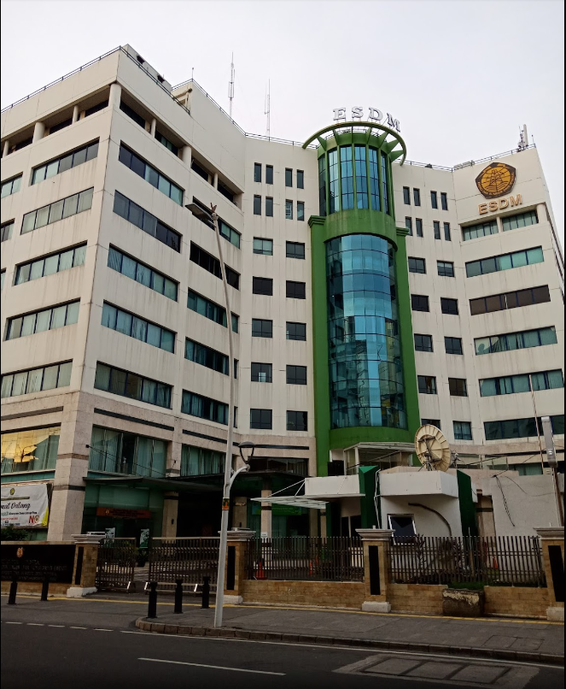
THANK YOU
Adress
www.esdm.go.id
Jl. Pegangsaan Timur No.1, Cikini, Menteng Jakarta
Kementerian Energi dan
Sumber Daya Mineral
@kesdm
@KementerianESDM
KementerianESDM

